Slide 1
BUYER-SELLER MARKET FOR BOOKS

Slide 2




TEAM PRESENTATION
TEAM NAME: BC_TEAM_6
Sameer Kasivajhula FULL STACK DEVELOPER
MANISH REDDY FRONTEND DEVELOPER
Manasa Raghavaraju BACKEND DEVELOPER
Sai Manikanta BACKEND DEVELOPER

Slide 3
PROJECT ABSTRACT
The Project entitled ‘Decentralized Buyer-Seller Market for Books’ is a Website model for an e-commerce application which allows users to participate in buying or selling of books. This model helps the users to add books they own and sell them for ether. User can buy books posted online and resell after completing them. We implement this model on Blockchain to achieve decentralization and use Smart Contracts to make the transaction secure and efficient.
We use Solidity as Programming language for developing the Smart Contracts for the project. React (JavaScript Library) is used for developing the web pages. Truffle and Ganache-cli are used in development process of the backend. This model runs on Ethereum Network.

Slide 4
INTRODUCTION
This web application is an e-commerce model in which adding, selling, buying and reselling of books can be performed. This application provides a platform to buy, sell and resell books by users on Blockchain to achieve decentralization and perform secure and efficient transactions.
PURPOSE OF THE PROJECT:
To develop a decentralized platform using Blockchain technology to achieve secure and efficient transactions for users to add, buy, sell and resell books at their convenience.
SCOPE OF THE PROJECT:
In the proposed system, the users can buy books using Ether (Cryptocurrency) on the Ethereum Blockchain Network. The proposed model is decentralized with Smart Contract implementation.

Slide 5
INTRODUCTION
FEATURES OF THE PROJECT
The model uses Blockchain technology to achieve decentralization.
Ethereum Blockchain Network is used and Ether is used to buy books.
The transactions are secure and efficient. Smart Contracts are developed to implement the transactions efficiently.

Slide 6
SOFTWARE REQUIREMENTS:
● Any web browser with the latest version.
● Operating Systems can be Windows XP and above.
● NodeJS
● Truffle (Development Environment and Testing Framework)
● Ganache-cli (Ethereum Development Tools)
● React (JavaScript Library)
● MetaMask Extension in the Browser
HARDWARE REQUIREMENTS:
● Ram : 2GB Ram and above
● Hard Disk : 50GB and above
● Processor : Dual core and above

Slide 7
1 day
0 days
0 days
0 days
0 days
4 days
5 days
1 day
1 day
2021
PROJECT PLAN
Documentation Quick Plan
Mar 27
Assign Roles
Mar 27
Requirement Analysis
Mar 27 - Mar 28
Develop Wireframes
Mar 28
Develop Solidity Files
Mar 28 - Apr 1
Develop User Interface
Mar 28 - Apr 2
Integration
Apr 2 - Apr 3
Testing
Apr 3 - Apr 5
Submission
Apr 5
Project Planning
Project Implementation
Integration
Project Testing
Project Submission
Mar 27
Mar 28
Apr 2
Apr 3
Apr 3
Day 1
2
3
4
5
6
7
8
9
10
2021

Slide 8
GANTT CHART
 | Week 1 |  |  |  |  |  |  | Week 2
 | 1 | 2 | 3 | 4 | 5 | 6 | 7 | 8 | 9 | 10
Planning and Assign Roles
Requirement Analysis
Develop Wireframes
Develop Smart Contracts (Solidity)
Develop User Interface
Integration
Testing
Submission

Slide 9
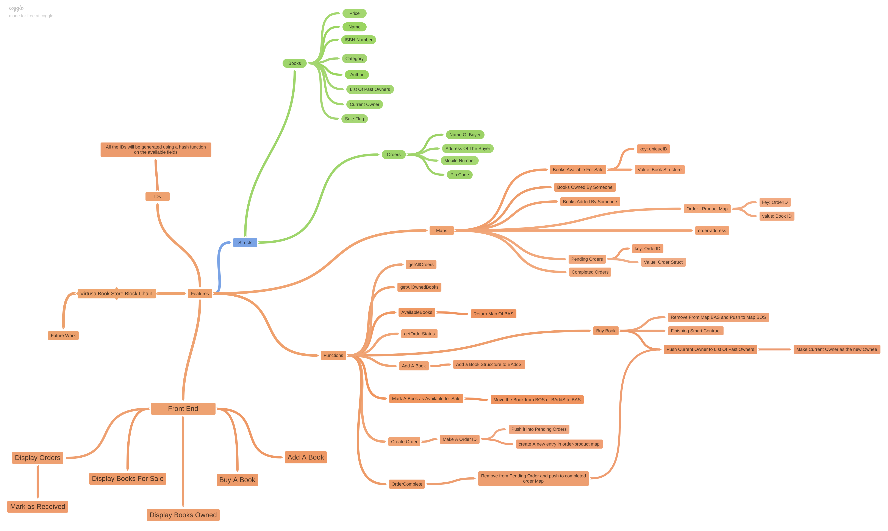
FLOW DIAGRAM

Slide 10
INTRODUCTION TO THE TECHNOLOGIES USED

Slide 11
BLOCKCHAIN
The first blockchain was conceptualized by a person (or group of people) known as Satoshi Nakamoto in 2008. Nakamoto improved the design in an important way using a Hashcash-like method to timestamp blocks without requiring them to be signed by a trusted party and introducing a difficulty parameter to stabilize rate with which blocks are added to the chain. The design was implemented the following year by Nakamoto as a core component of the cryptocurrency bitcoin, where it serves as the public ledger for all transactions on the network.

Slide 12
BLOCKCHAIN
A blockchain is a decentralized, distributed, and oftentimes public, digital ledger consisting of records called blocks that is used to record transactions across many computers so that any involved block cannot be altered retroactively, without the alteration of all subsequent blocks. This allows the participants to verify and audit transactions independently and relatively inexpensively. A blockchain database is managed autonomously using a peer-to-peer network and a distributed timestamping server. They are authenticated by mass collaboration powered by collective self-interests. Such a design facilitates robust workflow where participants' uncertainty regarding data security is marginal. The use of a blockchain removes the characteristic of infinite reproducibility from a digital asset. It confirms that each unit of value was transferred only once, solving the long-standing problem of double spending.

Slide 13
BLOCKCHAIN
The first blockchain was conceptualized by a person (or group of people) known as Satoshi Nakamoto in 2008. Nakamoto improved the design in an important way using a Hashcash-like method to timestamp blocks without requiring them to be signed by a trusted party and introducing a difficulty parameter to stabilize rate with which blocks are added to the chain. The design was implemented the following year by Nakamoto as a core component of the cryptocurrency bitcoin, where it serves as the public ledger for all transactions on the network.

Slide 14
TYPES OF BLOCKCHAIN
PUBLIC
A public blockchain has absolutely no access restrictions. Anyone with an Internet connection can send transactions to it as well as become a validator . Usually, such networks offer economic incentives for those who secure them and utilize some type of a Proof of Stake or Proof of Work algorithm. Some of the largest, most known public blockchains are the bitcoin blockchain and the Ethereum blockchain.
PRIVATE
A private blockchain is permissioned. One cannot join it unless invited by the network administrators. Participant and validator access is restricted. To distinguish between open blockchains and other peer-to-peer decentralized database applications that are not open ad-hoc compute clusters, the terminology Distributed Ledger (DLT) is normally used for private blockchains.

Slide 15
TYPES OF BLOCKCHAIN
HYBRID
A hybrid blockchain has a combination of centralized and decentralized features. The exact workings of the chain can vary based on which portions of centralization decentralization are used.
SIDECHAINS
A sidechain is a designation for a blockchain ledger that runs in parallel to a primary blockchain. Entries from the primary blockchain (where said entries typically represent digital assets) can be linked to and from the sidechain; this allows the sidechain to otherwise operate independently of the primary blockchain.

Slide 16
ETHEREUM
Ethereum was initially described in a white paper by Vitalik Buterin, a programmer and co-founder of Bitcoin Magazine, in late 2013 with a goal of building decentralized applications. Buterin argued that Bitcoin and blockchain technology could benefit from other applications besides money and needed a scripting language for application development that could lead to attaching real-world assets, such as stocks and property, to the blockchain. In 2013, Buterin briefly worked with eToro CEO Yoni Assia on the Colored Coins project and drafted its white paper outlining additional use cases for blockchain technology. However, after failing to gain agreement on how the project should proceed, he proposed the development of a new platform with a more general scripting language that would eventually become Ethereum.

Slide 17
SMART CONTRACTS
A smart contract is a computer program or a transaction protocol which is intended to automatically execute, control or document legally relevant events and actions according to the terms of a contract or an agreement. The objectives of smart contracts are the reduction of need in trusted intermediators, arbitrations and enforcement costs, fraud losses, as well as the reduction of malicious and accidental exceptions.
Smart contracts were first proposed in the early 1990s by Nick Szabo, who coined the term, using it to refer to "a set of promises, specified in digital form, including protocols within which the parties perform on these promises"

Slide 18
REACT
React (also known as React.js or ReactJS) is an open-source, front end, JavaScript library for building user interfaces or UI components. It is maintained by Facebook and a community of individual developers and companies. React can be used as a base in the development of single-page or mobile applications. However, React is only concerned with state management and rendering that state to the DOM, so creating React applications usually requires the use of additional libraries for routing, as well as certain client-side functionality.
React was created by Jordan Walke, a software engineer at Facebook, who released an early prototype of React called "FaxJS". He was influenced by XHP, an HTML component library for PHP. It was first deployed on Facebook's News Feed in 2011 and later on Instagram in 2012. It was open-sourced at JSConf US in May 2013.

Slide 19
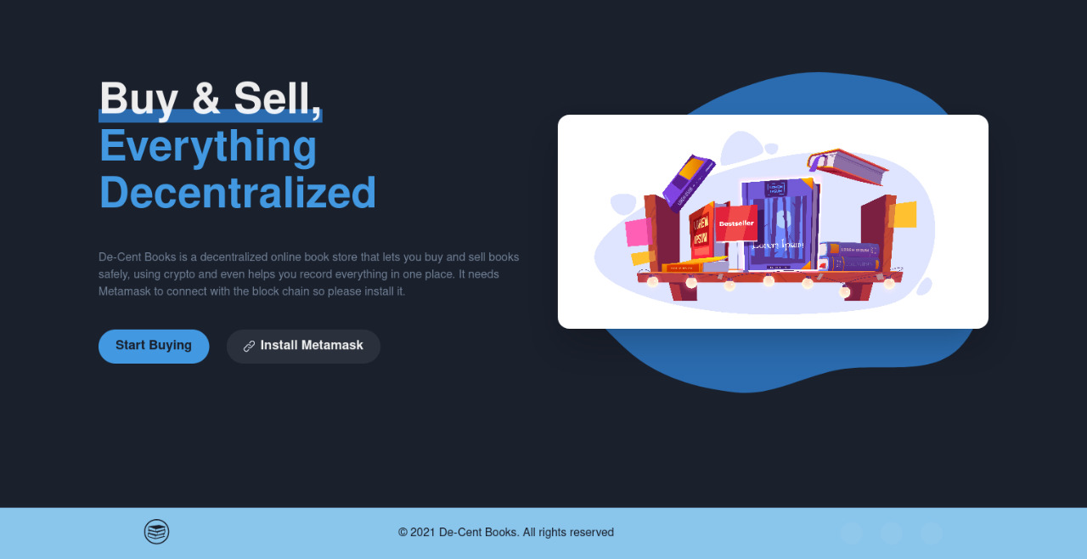
OUTPUT SCREENSHOTS
Home page

Slide 20
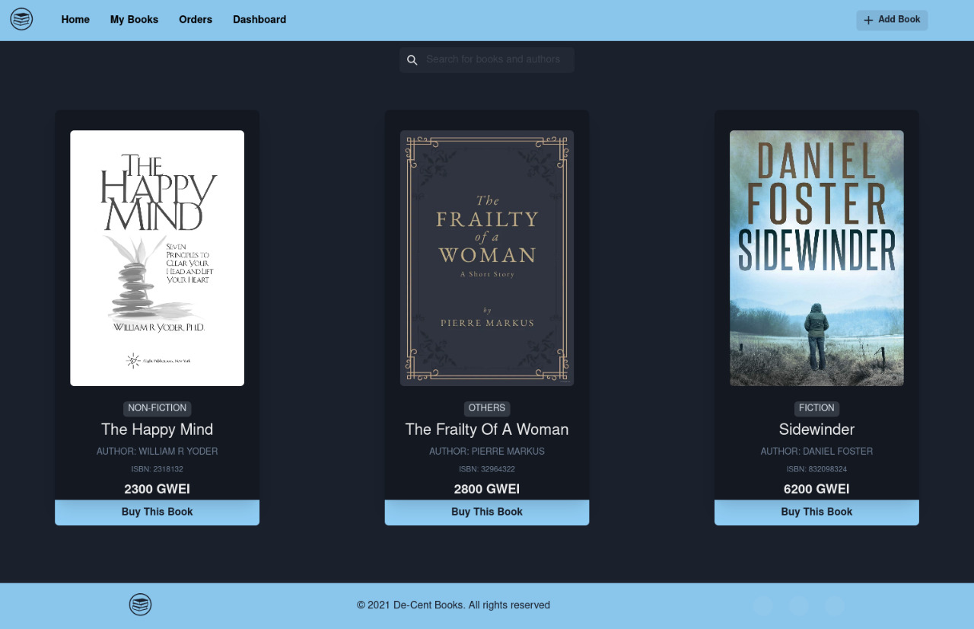
OUTPUT SCREENSHOTS
Books for Sale

Slide 21
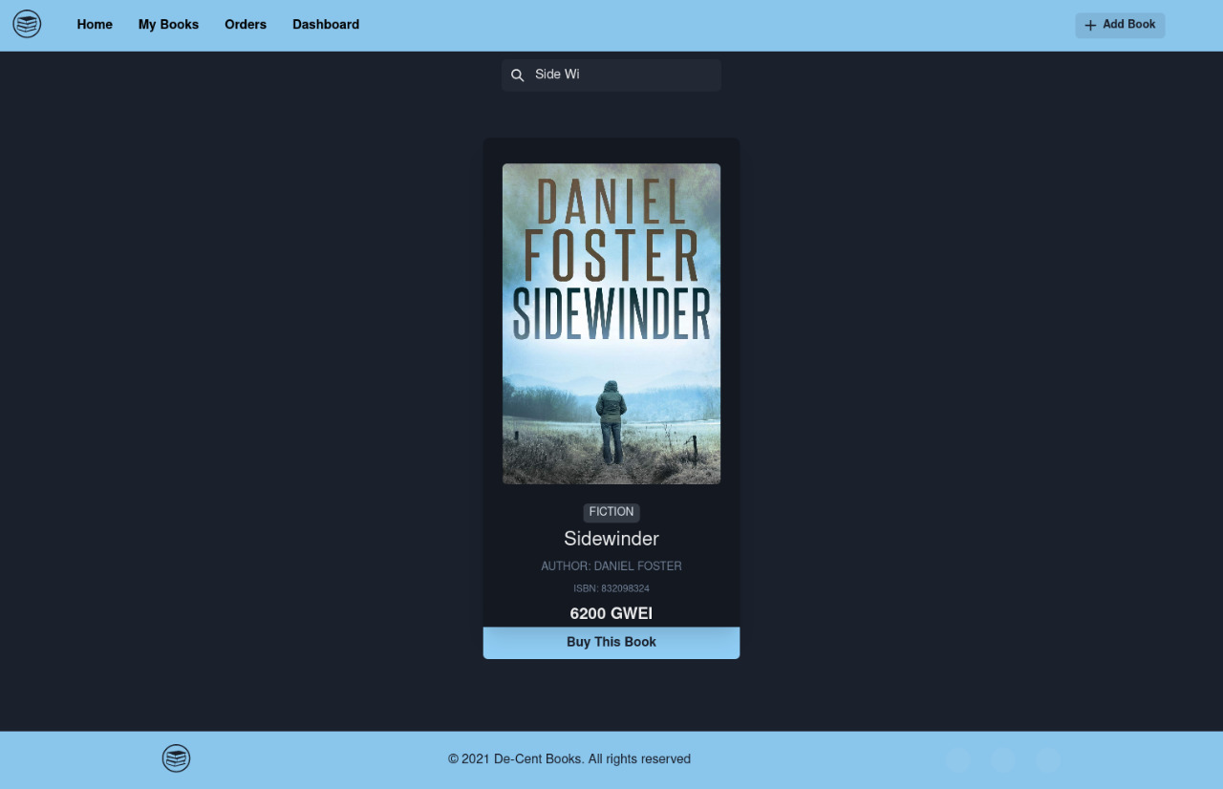
OUTPUT SCREENSHOTS
Search Books

Slide 22
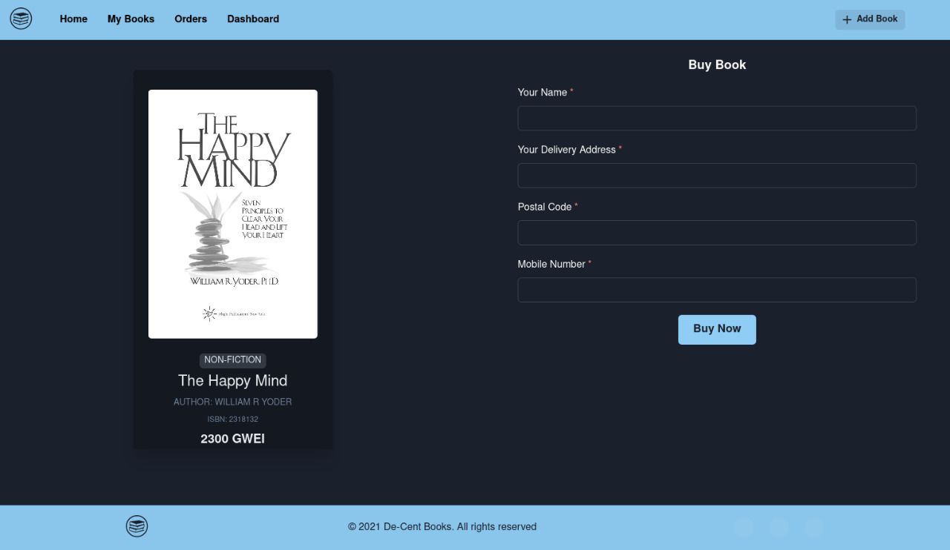
OUTPUT SCREENSHOTS
Buy Books

Slide 23
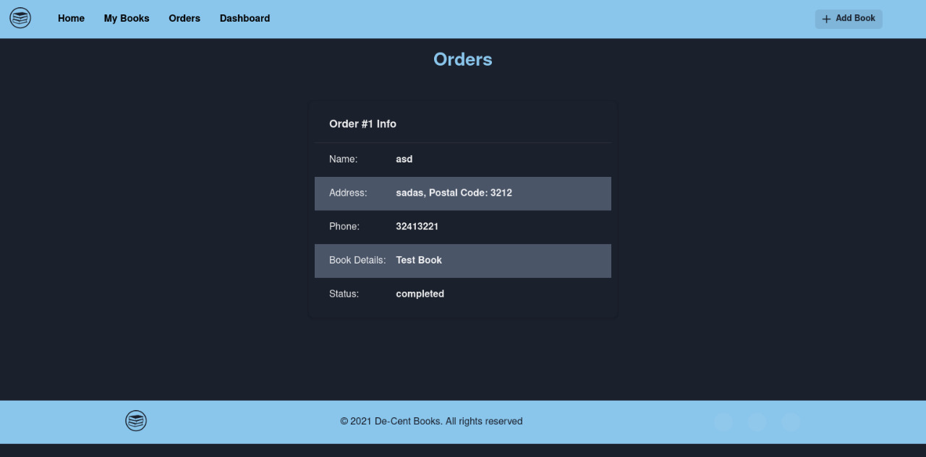
OUTPUT SCREENSHOTS
Order Summary

Slide 24
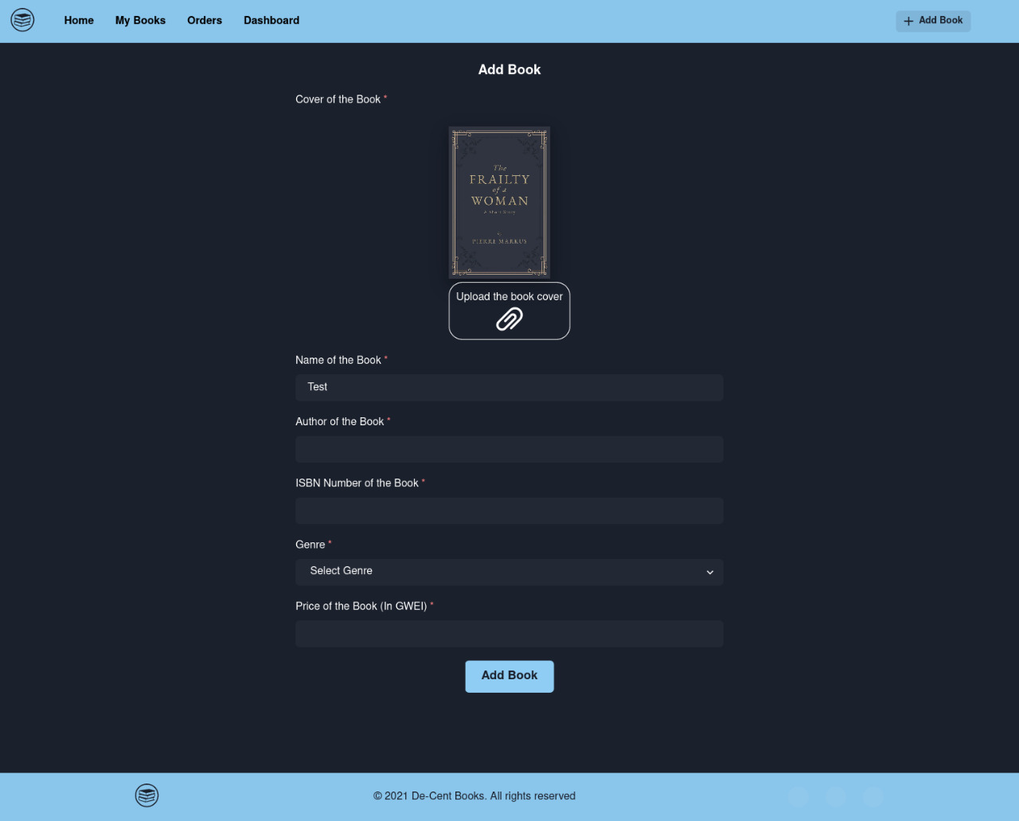
OUTPUT SCREENSHOTS
Add Book

Slide 25
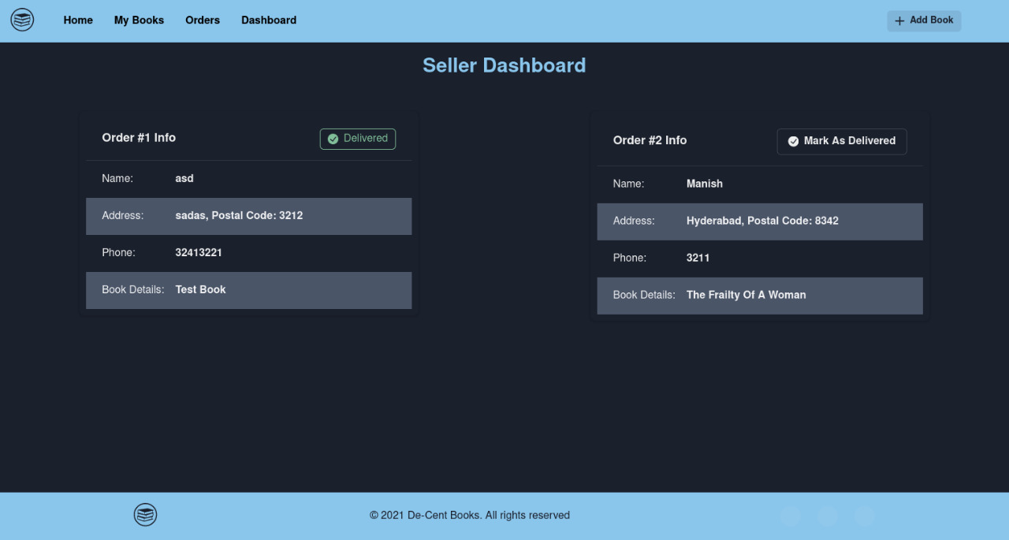
OUTPUT SCREENSHOTS
Seller Dashboard

Slide 26
CONCLUSION
Through this web app, users can add, sell, buy and resell owned books using Ether on the Ethereum Blockchain Network.
Using this model, decentralization is implemented thus providing secure and efficient transactions to the users.

Slide 27
FUTURE SCOPE
This model can also be implemented for e-Books using ERC721 Non-Fungible Tokens which provide one NFT to each book. The owner of the token will be the owner of the book. The Ether transactions can be put on hold until the buyer receives the book thus implementing the Smart Contracts to their full extent.

Slide 28
BIBLIOGRAPHY
Books used for collecting the information are:
Mastering Ethereum by Merunas Grincalaitis
The following websites are used for collecting the information:
www.wikipedia.com
http://stackoverflow.com/

Slide 29
THANK YOU!

